Slide 1
Get Noticed
Getting the job
Notes:
Instructor:
Read through the whole lesson (including all the notes) before the day of class
Make note of and gather any supplies you need to bring
Prepare examples, stories
Think through how much time you want to spend on individual activities; make notes
Be sure to allow time to announce the assignment at the end
Overview:
Intro (slides 1-4): 4-6 minutes
Resumes: 20-25 minutes
Cover letters: about 10 minutes
Interviews: about 10 minutes
Wrap-up: 1-2 minutes
(You’ll notice that if you spent the maximum suggested time in each section, you’d go over 50 minutes)

Slide 2
Review
Applied Math Power:
The importance of this field in the world economy
Jobs you’ll be looking for
Notes:
Ask: What did we go over last class?

Slide 3
Today
Objectives:
Learn to value and sell your skills with STAR
Practice STAR in a fictitious context, then a real context
Consider and practice selling your skills while networking (STEM Fair)
Notes:
Read aloud or call on class members to read aloud

Slide 4

Get noticed
We’ve determined that this is an awesome field to be in. So….now what?
How do you actually get that job?
How do you go from having skills to using those skills to make money?
Notes:
Image from pexels.com

Slide 5

Notes:
Here’s a humorous video showing what not to do (from Big Bang Theory):
Video: https://www.youtube.com/watch?v=w21cmT-T9H8
It may take 30 seconds to load (sometimes it helps to go to the next slide and then go back).
Transition: “This lesson focuses on that part of job-getting .”

Slide 6
Valuing your skills
Notes:
Valuing skills (slides 6-11): 12-15 minutes

Slide 7
Your skills
First, you need to know your skills and be able to communicate them effectively to others:
Verbally (networking & interviewing), and
In writing (résumé & cover letter)
Today’s focus will be on talking about your skills in interviewing and networking.
Next week, we will practice applying this to résumés and cover letters.

Slide 8
Activity
1. Mad math skills
2. Flower arranger
3. List writer
4. ?
Individual: make a list of 3-5 things that you know you do well
Consider: when was I at my best? What was I doing?
Group: everyone write those 5 things on the board (whiteboard, chalkboard)
Notes:
Duration:1-2 minutes per activity

Slide 9
Discuss
What “themes” do you see on the board?
Do you see any patterns?
Take-away: ACME students have distinct skills that are useful to employers
Problem: selling these skills can be a challenge (and not just for ACME students)
Notes:
Image from pixabay.com

Slide 10

Small group activity
Arrange yourselves into pairs
Sell the other person on your skill!
Make it catchy, believable, persuasive, etc.
Notes:
Opening Transition: Knowing what you do well is one thing – now, how will you sell it?
-If there are an odd number of students, the teacher can participate; if not, the teacher facilitates and observes
-After about 1 minute, tell people to switch roles
Image from www.lespeeddating.com

Slide 11
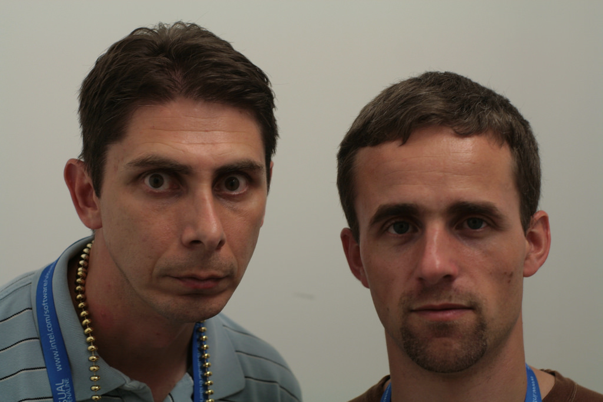
Activity review
What happened?
Was it easy to talk about your skills? Why, or why not?
Take-away: it’s easier to talk about your skills when you have a predetermined strategy for doing so
The strategy we will learn is called STAR
Notes:
Brief class discussion
(it is assumed that it was indeed difficult for students to up and talk about their skills)
Image from flickr.com

Slide 12

STAR
Notes:
Image from en.wikipedia.org
STAR (slides 12-26): 25-30 minutes
Networking: about 5 minutes
Wrap-up: 1-2 minutes

Slide 13

STAR
STAR is a powerful, simple tool to help you share your skills. It stands for:
Situation: Who, what, where, when, how
Task: The task you had to complete, including challenges and constraints
Action: What you did to complete the task
Result: What you achieved and learned from the experience
It’s a way of breaking down something that you do well into a result that an employer can use. Essentially, it’s systematic problem-solving.
Notes:
Image from pixabay.com

Slide 14
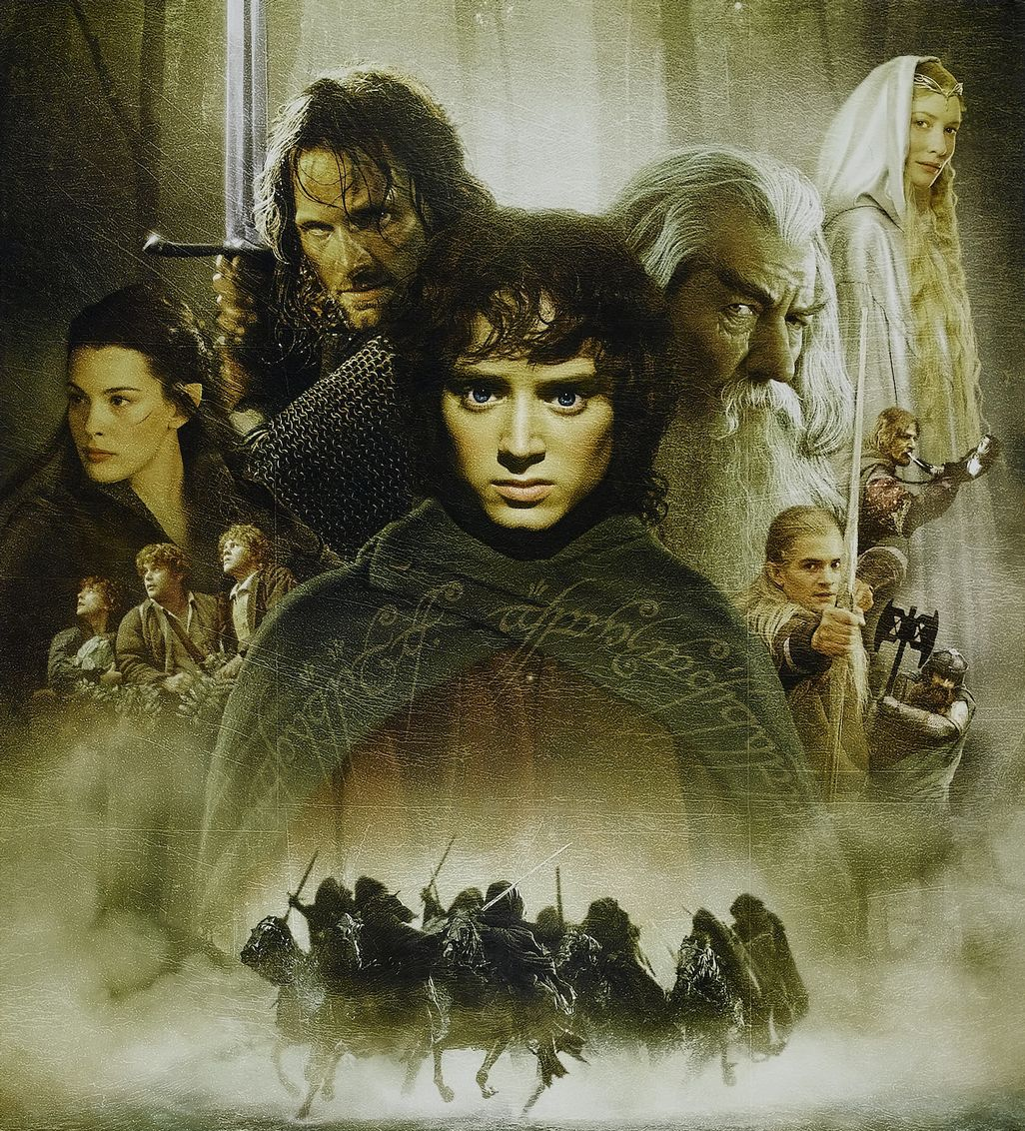
Application Activity
Let’s break apart the story of something we all likely know very well – the characters and story from the Lord of the Rings saga
(If you don’t know Lord of the Rings well, frankly, I’m just sad for you.)
While watching the following video consider the situation, tasks, actions, and results from the point of view of each character in the film clip
Notes:
Let’s have the students break apart the story of something they likely know very well – LOTR
Image from http://lotr.wikia.com/

Slide 15
Notes:
https://www.youtube.com/watch?v=TrJJ6ncp1fc
Fellowship of the Ring, extended edition

Slide 16
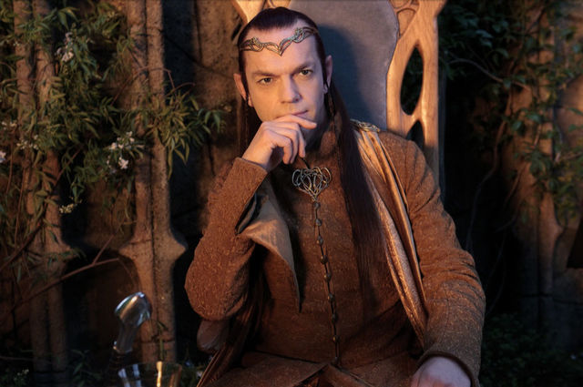
S – Situation
What’s the situation from Elrond’s perspective?
Notes:
This might seem overly simplistic, but encourage the students to play along – added complexity comes in a bit
Image from http://lotr.wikia.com/

Slide 17

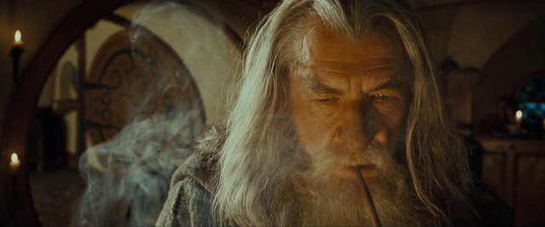
T – task
What was the main task from:
Elrond’s perspective?
Gimli’s perspective?
Gandalf’s perspective?
How were these tasks related?
Disparate?
Notes:
Choose two of the characters to compare and contrast
Images from http://lotr.wikia.com/

Slide 18
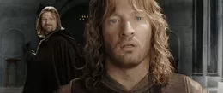
A – action
What actions were taken by:
Elrond?
Boromir?
Faramir?
Denethor?
How did Boromir’s actions influence Faramir’s actions?
Denethor’s?
Notes:
You may want to discuss just 2-3 characters
Image from http://lotr.wikia.com/

Slide 19


R – result
What results were achieved by:
Elrond?
Frodo and Sam?
Aragorn, Legolas, and Gimli?
Merry and Pippin?
How were the results achieved by these parties convergent? Divergent?
Notes:
Again, you may not have time to discuss all of the character.
Photos from http://lotr.wikia.com/

Slide 20
STAR stories
STAR is most effective when shared like a story, one part flowing to the other
Using a story allows you to convey specifically and systematically what your role was in finding a solution to a difficult situation.
Thus, potential employers (for example) can see how what you did might be replicated in their environment.
Let’s try this now – but still in the LOTR context

Slide 21

Example: STAR story
“I once had ten used 50-gallon drums of honey that needed to be cleaned, and I was very tired and they had to be cleaned with a hot-water pressure washer. I knew that it would be difficult, but I placed my responsibility before my personal feelings. I worked hard and finished the job thoroughly before my deadline, and then returned to my boss to report on what I’d done.”
Notes:
Instructor: share a prepared STAR story about a time when you did something well.

Slide 22
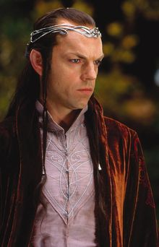
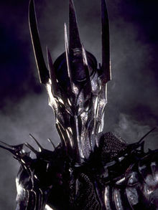
Further application
With your partner, share a STAR story from the LOTR saga from the perspective of a character of your choice, as if pitching your skills to one of two potential employers: Sauron “the Abhorred,” or Elrond, Lord of Rivendell.
Feel free to choose a more obscure character, such as the Witch King of Agmar or Grima Wormtongue
Be as specific as you’d like.
Examples:
“After I raised my staff in the air, I wielded the Flame of Anor in a spectacular protective fashion, fending off the Balrog long enough for the company to escape.”
“Then I chased down the invisible vermin and bit off his finger.”
Notes:
Anyone not conversant in LOTR may choose a character from Star Wars, Dr. Who, Harry Potter, etc.
(3-5 minute activity)
After about 2 minutes, tell students to switch roles, if they haven’t already

Slide 23

Reflection
How did it go?
Did your understanding of how to use STAR increase?
What would make your pitch more effective?
Notes:
Instructor: Poll the class: who gave the most convincing pitch?
Have the students vote for the favorite and have him/her share for the class (extra credit?)
Image from pixabay.com

Slide 24
Personal application
Now that the concept is firmly cemented in your minds let’s apply STAR to a “story” from your own lives:
Consider something that you do well (preferably at work), and think of a time when you applied it with success
Share your story with a partner
Notes:
About 3 minutes to think up a story, and 2 minutes to share (1 minute each)

Slide 25

Reflection
Was this better than the first time you tried to sell your skill?
Why, or why not?
Notes:
www.publicdomainpictures.net

Slide 26
Bottom line:
Use STAR to be specific and categorical in describing your skills and successes

Slide 27
Networking
Notes:
Networking: about 5 minutes
Wrap-up: 1-2 minutes

Slide 28

Networking
Discuss:
What comes to your mind when you think of networking?
Can you think of examples when networking has opened up opportunities for you?
How do you think networking could benefit you in future?
Notes:
Instructor: Have a few examples in mind to share, in case class members don’t readily share their own
Image from flickr.com

Slide 29

Networking
Essentially, the purpose of networking is two-fold:
Other people have jobs / job openings—draw on your network to help you find a good job.
Other people have distinct skills that you may not have—reach out to people be on your team or to help you do your job.
If you don’t network, you might be very smart, but very broke.
Notes:
Image from pixabay.com

Slide 30
Activity: Middle-Earth Mingling
Move the desks to the sides of the room.
Grab a nametag and write the name of any character from LOTR, good or evil.
Act as that character with specific situations in mind.
Mingle with each other as if in a networking situation, doing your best to share your stories with each other and convince others to join your ranks.
Each student will have 5 blank pieces of paper.
Give a piece of paper to each classmate who sells their character and his/her actions very well.
At the end of the activity, the student with the most paper wins and is pronounced “Lord of Moria,” “Wielder of the Flame of Udun,” or whatever title is deemed appropriate.
Notes:
Again, characters from another series can be substituted if a student is not conversant with LOTR
NOTE THE SUPPLIES NEEDED FOR THIS ACTIVITY:
nametags
5 blank pieces of paper (or other tokens) for each person
Instruct students to be forthcoming with their character’s distinct skills, and to also be on the lookout for other characters whose skills compliment their character’s.

Slide 31

Reflection
Who won?
Why did they win?
What did you do well?
What could you have done better?

Slide 32
Assignment
Visit the STEM fair and talk with at least 3 recruiters
Sell your strengths
Learn about what they do
Evaluate your pitch, make it better
Bring 2 copies of your updated résumé to our next class (if you don’t have a résumé, look up basic résumé formatting online and bring something to class)
Notes:
Wrap-up: 1-2 minutes

Slide 33
Review
Objectives:
Learn to value and sell your skills with STAR
Practice STAR in a fictitious context, then a real context
Consider and practice selling your skills while networking (STEM Fair)

Slide 34
Additional resources
Star stories:
https://www.youtube.com/watch?v=0nN7Q7DrI6Q
http://lifehacker.com/5960201/use-the-star-technique-to-ace-your-interviews
http://www.huffingtonpost.com/alan-carniol/inside-the-star-interview_b_3310122.html
https://careerservices.wayne.edu/behavioralinterviewinfo.pdf
How to Ace an Interview: https://www.youtube.com/watch?v=DHDrj0_bMQ0

